Slide 1
Industry Trends & Insight—A Year in Review
William Beale
Director, HB Retirement
Accredited Investment Fiduciary®
Megan Warzinski
Manager of Consulting Services
Accredited Investment Fiduciary®

Slide 2

Overview of Our Firm
Full-service institutional retirement consulting and advisory firm
Specializing in all areas of retirement plan and executive benefit consulting
Nominated for Planadviser Magazine’s Adviser Team of the year 2006-2017
Headquartered in the Henderson Brothers’ Building, Pittsburgh, PA.
Supported by the strength and resources of LPL Financial and Global Retirement Partners (GRP)
LPL Financial Retirement Partners-Top 10 in the country

Slide 3
Disclosure
For Plan Sponsor Use Only – Not for Use with Participants or the General Public
This information was developed as a general guide to educate plan sponsors, but is not intended as authoritative guidance or tax or legal advice. Each plan has unique requirements, and you should consult your attorney or tax advisor for guidance on your specific situation. In no way does advisor assure that, by using the information provided, plan sponsor will be in compliance with ERISA regulations.
Securities offered through LPL Financial, Member FINRA/SIPC. Investment advisory services offered through HB Retirement, a registered investment advisor and separate entity from LPL Financial.

Slide 4
Recently Implemented Changes
Bipartisan Budget Act of 2018 passed earlier this year.
Included 3 provisions which will give retirement plans greater flexibility in handling hardship distributions:
  Change to the Six-Month Suspension Rule
  Expansion of Available Sources
  Elimination of Loan Requirement

Slide 5
Legal & Regulatory Update
Executive Order (EO) signed on August 31 directing the Department of Labor and the Treasury to review and consider issuing regulations regarding increasing access to workplace retirement savings arrangements.
EO references Multiple-Employer Plans, asking for the DOL to consider issuing new regulations for employers to join such plans.
EO also addresses:
  70 ½ required minimum distributions
  Life expectancy and distribution tables
  Plan notice requirements

Slide 6
401k Student Loan Benefit Programs
IRS recently release private letter ruling:
  Addressed an employer seeking to offer a student loan benefit program as a part of 401k plan.
  Proposal allows employer to make non-elective contributions on behalf of the employee conditioned on the employee making student loan repayments.

Slide 7
Proposed Legislation
Automatic Retirement Plan Act
  If passed, Employee Benefit Research Insititute (EBRI) estimates it would reduce the $4.13 trillion retirement savings shortfall for US households by $645 billion, or 15.6%.
  Act would require all but the smallest employers to offer a retirement plan:
    6% automatic enrollment with reenrollment conducted every 3 years
    Automatic escalation of 1% every year up to a 10% cap

Slide 8
Proposed Legislation
Automatic Retirement Plan Act
  EBRI recommending auto-portability be considered as a part of the act.
    Would help eliminate cash-outs, which are particularly common for plans with low balances.
    Would further reduce the retirement savings shortfall by an additional $287 billion. Total combined reduction of 22.6% of deficit.

Slide 9
Proposed Legislation
Tax Cut 2.0
  Rothification—has long been rumored as a possible revenue-raiser to pay for tax reform.
Retirement Enhancement & Savings Act (RESA)
  Seeks to improve upon existing 401k Safe Harbor plan design by giving small business owners more flexibility to switch to a safe harbor plan
Other possibilities include:
  Universal Savings Account
  Increasing Cash Out Limits
  Annuity Safe Harbor

Slide 10
Financial Wellness

Slide 11

Financial Wellness
“The most important investment you can make is in yourself”
- Warren Buffet

Slide 12
Financial Wellness
  Financial Wellness Discussion Topics:
  The potential benefits for your employees and your company
  Definition of financial wellness
  Employer and employee attitudes
  How did everyone become so stressed out
  What does this stress cost the company
  What to consider in a financial wellness program
  Open discussion

Slide 13
Financial Wellness
“Do not save what is left after spending, but spend what is left after saving”
- Warren Buffet

Slide 14
Definition of Financial Wellness
  Consumer Financial Protection Bureau (CFPB):
Financial well-being is a state of being wherein a person can fully meet current and ongoing financial obligations, can feel secure in their financial future, and is able to make choices that allow them to enjoy life.
  EY:
An individual’s ability to make confident, well-informed money-related decisions resulting in financial security for both the short and long term.
Source https://files.consumerfinance.gov/f/201501_cfpb_report_financial-well-being.pdf and www.ey.com/EFS

Slide 15
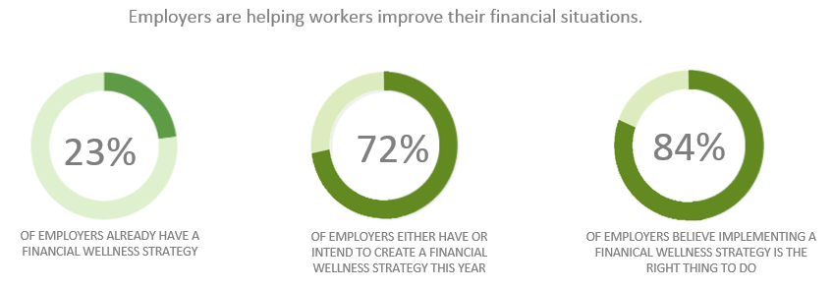
Employer Attitudes
Source: Aon Hewitt 2017 Hot Topics in Retirement and Financial Wellbeing

Slide 16
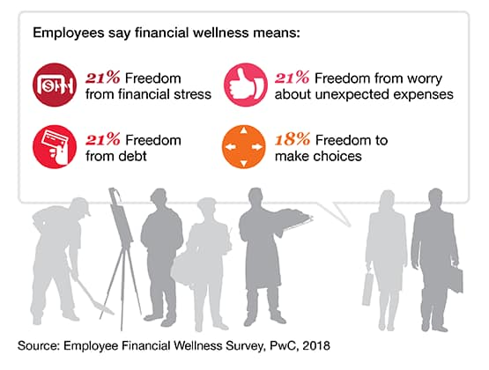
Financial Wellness Defined by Employees
Top answer by generation
Millennials:
26% being debt free
Gen X:
22% not being stressed about my finances
Baby Boomers:
24% having enough savings that I’m not worried about unexpected expenses

Slide 17
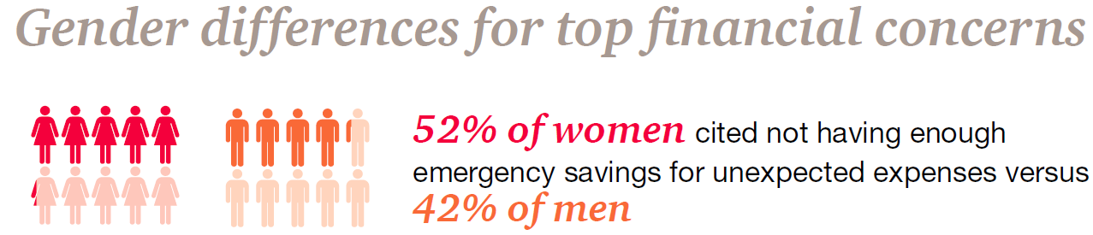
Employees Attitudes
  According to 2017 PwC survey on Financial Wellness:
  53%
  say they feel stressed dealing with their personal financial condition
    By generation
    35% Millennials
    44% Gen X
    21% Baby Boomer
    By gender
    59% female
    41% male
Gender Differences for Financial Concerns:
  Source: PwC Special Report: Financial stress and the bottom line September 2017

Slide 18
Employees Attitudes
  According to 2017 PwC survey on Financial Wellness:
  What areas of your life are being impacted (could pick more than one)
    28% say health
    23% relationship at home
    22% productivity at work
    12% missing work occasionally
    7% other
    37% none of these
  50% spend 3 or more hours/week at work dealing with personal financial stress
  Source: PwC Special Report: Financial stress and the bottom line September 2017

Slide 19

The impact of financially stressed workers on the bottom line
  Surveys show that employees are stressed out and spend an average of 3 – 5 hours per week at work on non-work related issues
Cost employers $5,000 per year per employee, on average
Reducing stress with just 10% of employees reduces costs by ~$500,000 per year
Source: http://www.forbes.com/sites/financialfinesse/2013/06/13/are-you-financially-stressed/
Source: https://www.kansascityfed.org/publicat/cap/carwp09-01.pdf
Notes:
Now let’s take a look at the problem of financially stressed workers and their impact to productivity.
Some employees spend work hours trying to work out their own financial issues. A 2010 Federal Reserve study estimates that companies lose an average of $5,000/year in productivity per employee due to financial issues that are being addressed during work hours.
The E. Thomas Garman studies from 2007 estimated an employer cost of approximately $2,000 for similar reasons.
MassMutual realizes that not all financial stress is retirement planning related, so a 10% reduction in financial stress was used to illustrate the savings companies may realize with improved retirement readiness for their employees. The calculation then becomes [1,000 employees *($5,000 of financial stress * 10% reduction)] = $500,000 per year of increased productivity.

Slide 20
The true impact of delayed retirement?
  What is the potential unidentified liability of delayed retirement on a company’s balance sheet
Potential areas of increased cost
Annual salary increase
Higher healthcare costs
Higher workers compensation costs
Higher match costs
Higher profit sharing costs
More vacation
Increased turnover (log jam)
Potential loss of productivity
73%
of workers over age 50 expect to delay retirement¹
Studies show that the average cost of a worker who delays retirement can equate to $50,000 annually².
¹ Source: https://www.planadviser.com/nearly-three-quarters-boomers-want-delay-retirement/ March 2018
²Source:http://research.prudential.com/documents/rp/SI20_Final_ADA_Cost-of-Delayed_1-4-17.pdf January 2017

Slide 21

Seeing Potential Warning Signs By Reviewing Plan Data
Are employees retiring on time with adequate savings?
Are participants opting out of auto-enrollment and auto-increase?
Is there a high volume of
plan-specific Web traffic or calls regarding loans, hardships, or access to money?
Do you currently offer a High Deductible Health Plan and an HSA?

Slide 22
Impact on Health Benefits
  Poll Questions:
How many of you offer a High Deductible Healthcare Plan with an HSA?
Do you view the HSA as more of a healthcare or retirement benefit?

Slide 23
Financial Wellness Matters To Employers
Impact on Health care costs
Financial stress manifests as:
Migraines/ Headaches
44%
15%
Insomnia/ Sleep trouble
Severe Depression
Stressed out employees are more prone to health risks.
Financial Stress is the #1 cause of stress-related illnesses¹
84% of employees report having some degree of financial stress²
24% higher healthcare costs in people who are stressed³
23%
39%
4%
17%
Severe Anxiety
High Blood Pressure
29%
Heart Attack
33%
4%
26%
6%
3%
Muscle Tension/
Back Pain
Stomach Ulcers
51%
27%
31%
8%
People with low levels
of financial stress
People with high levels
of financial stress
1. Research Works: Partnership for Workplace Mental Health report. Feb 2009.
2. Q2 Trends in Employee Financial Issues, Financial Finesse, September 2012.
3. Higher Health Care Costs for Metabolic Syndrome Risk, Disabled World, September 2009.
Notes:
Financial stress financially impacts your business by way of productivity, absenteeism and higher healthcare costs

Slide 24
Impact on Health Benefits
  Better management of chronic conditions can lead to improved retirement savings:
High Blood Pressure | Average Annual Pre-Retirement Healthcare Costs | Expected Longevity
Poorly Managed | $7,533 | 84 Years
Average Managed | $6,292 | 86 Years
Well Managed | $5,299 | 87 Years
Difference (Poorly to Well) | $2,234 | +3 Years
Type II Diabetes | Average Annual Pre-Retirement Healthcare Costs | Expected Longevity
Poorly Managed | $7,004 | 72 Years
Average Managed | $5,682 | 76 Years
Well Managed | $5,065 | 80 Years
Difference (Poorly to Well) | $1,939 | +8 Years
Source Healthy Capital Study – Health & Retirement Savings: Leveraging Healthcare Costs to Drive 401(k) Contributions & Improve Health

Slide 25
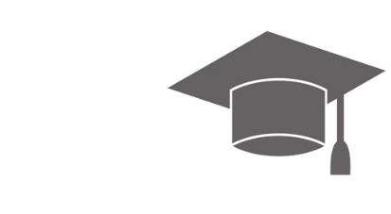


Employee Demographics
Does the company have a high proportion of young employees who may have significant debt?
Is the company in an industry (e.g. law firm or medical practice) that may hire young employees with a significant amount of college debt?
Does the company have an aging population that may need assistance with tax strategies, estate planning, etc., as they approach retirement?

Slide 26

Corporate Culture and Philosophy
Is a primary reason for offering a competitive benefits package to recruit, retain, and reward top talent?
Is your company paternalistic, wanting to give employees the best opportunity for replacement income ratios that are superior to the industry?
Are you willing to devote the time and resources to supporting a robust financial wellness program?
Who will own it (HR, Benefits, Retirement)?
Should you look to outsource a financial wellness benefit?

Slide 27
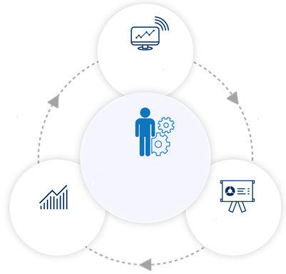
Delivering an Effective Financial Wellness Program
A turnkey, multi-channel, holistic approach with coordinated in-person and technology enabled learning opportunities.
Online Financial Learning Center
Financial Wellness Assessment provides personalized action plan, directing them to your workshops and webcasts.
Financial coach addresses individual issues and helps them take the steps needed to prepare for the future.
Personalized
Programs Designed to Deliver Behavioral Change
Financial
Helpline
Workshops &
Webcasts
Education sessions delve into key financial topics and offer helpful action items to improve financial habits.

Slide 28
Five Styles of Financial Wellness Programs
  Tools
Education and Literacy
Coaching and Behavioral
Services and Products
Enhanced Employee Education Programs

Slide 29
Considerations for Selecting a Financial Wellness Provider
Budget or Cost
Business Model
Communication Frequency
Data Reporting Capabilities
Integration with other Benefits

